Slide 1
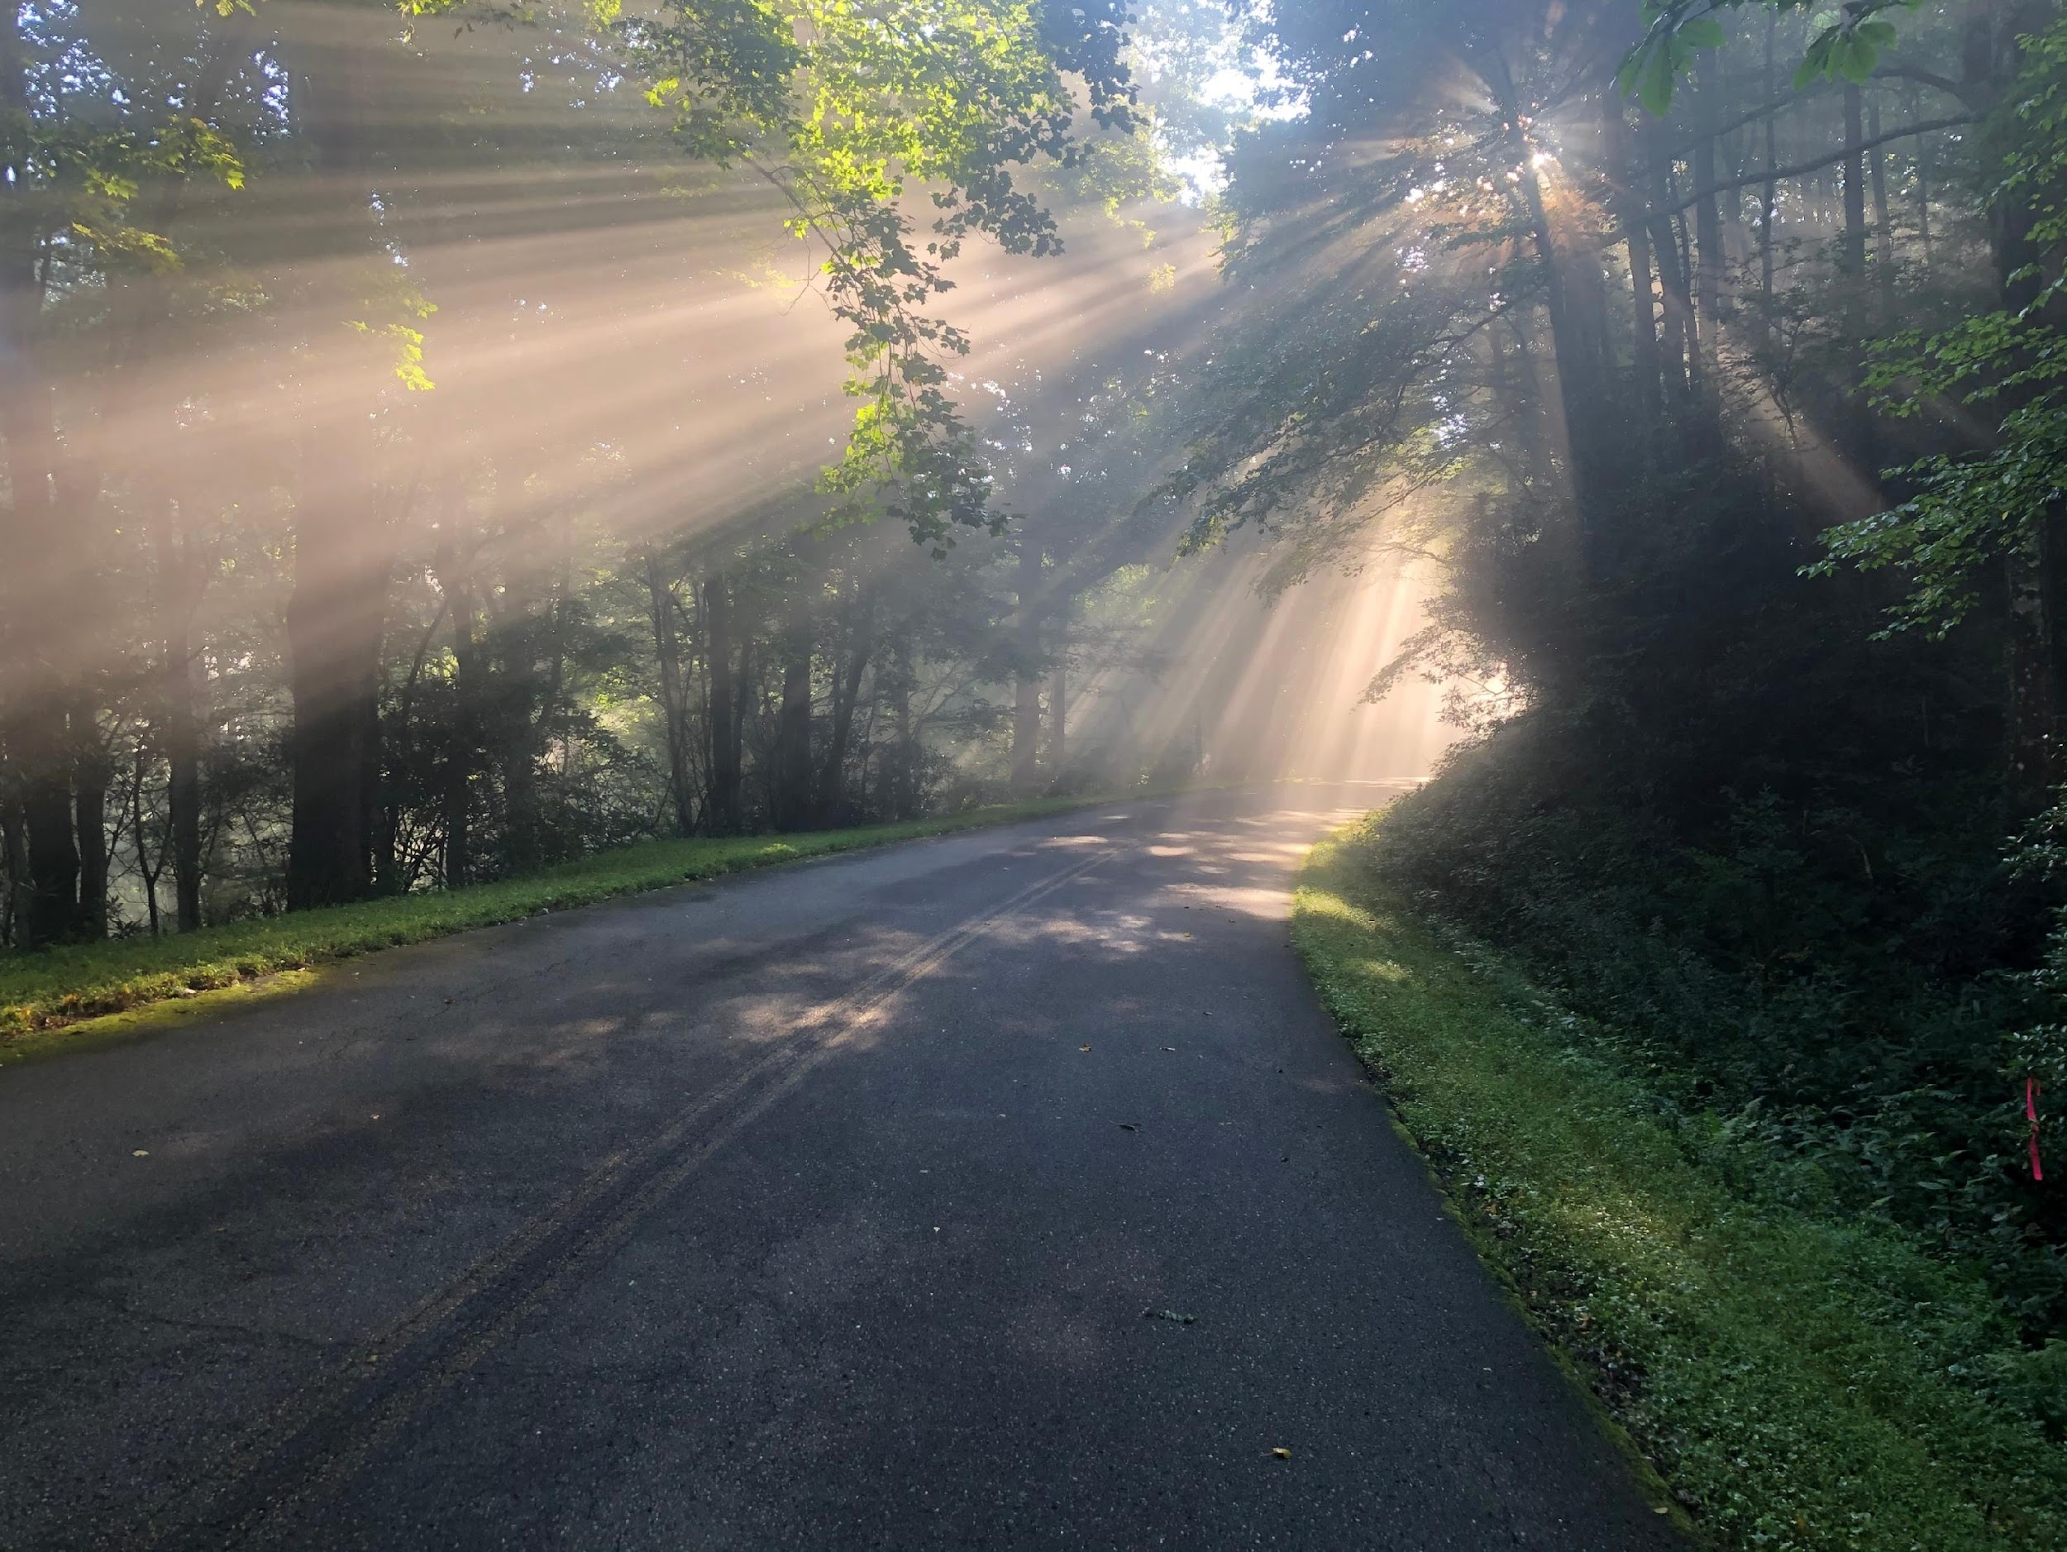
Date Event Location Details
Dave Schweikert’s WhyIRide.org 2023 schedule
Feb TBD | Indiana’s Gravel Roundabout and more! | Attica, Indiana | 125 miles, 3000 ft- and 1 gravel roundabout
March 4/5 | Boiler Up 100k OR Half Rock 100k | Lafayette/Attica, IN | Indiana Randonneurs events
April 8 | Dirty 30 Xdirty 130 | Saranac, MI | 130 miles, 5000ft- part of Michigan Gravel Race Series
April 22 | Ohio Randonneurs Lancaster 300k | Lancaster, Ohio | 300km (187 miles) & 11k ft of climbing through Southeastern Ohio
Wed May 17- 7pm | Ride of Silence | Locations worldwide including Indianapolis | Honoring cyclists killed while riding on public roads
May 27 – June 3 | Pedal to Empower: “Strava Art” Guinness World Record attempt- to benefit Filter of Hope & World Bicycle Relief | South Dakota, Nebraska, Minnesota | 950 miles & 24k feet to draw “the world’s largest cross”
June 17-21 | Self-supported tour of Scotland and England’s Lake District | Scotland & England | Edinburgh- Scottish Highlands & Lake District
July 22 | Dust Bowl 100 | Eminence, Indiana | 100 miles of Indiana gravel
August 12 | Watermoo 111 | Dexter, MI | 111 miles of Michigan gravel- part of Michigan Gravel Race Series
Sept 16 | Detroit Randonnuers Trail Mix 200k | Rochester, MI | 200k of mixed terrain
Oct 28 | Lowell 100 | Lowell, MI | part of Michigan Gravel Race Series
Come ride with us! WhyIRide.org

